Slide 1

Today’s lesson
1.30 Work Done in a Gravitational Field

Slide 2






Year 11 Concept of WORK.
$$PE \left(2\right)=mgh_{2}$$
Work is done whenever an objects ENERGY changes.
Total Work done is equal to the change in energy. (J)
If you lift a cat high into the air, WORK is done because its Gravitational Potential increases.
$$W=∆PE=∆mgh$$
$$W=mgh_{2}−mgh_{1}$$
$$W=mg(h_{2}−h_{1})$$
$$PE \left(1\right)=mgh_{1}$$

Slide 3

Year 11 Concept of WORK.
$$PE \left(2\right)=mgh_{2}$$
Work is done whenever an objects ENERGY changes.
Total Work done is equal to the change in energy. (J)
If you DROP the cat, WORK is done because its Gravitational Potential decreases and Kinetic Energy increases.
Energy is NOT a Vector Quantity.
The work done in either direction is the same.
$$W=∆PE=∆mgh$$
$$W=mgh_{2}−mgh_{1}$$
$$W=mg(h_{2}−h_{1})$$
$$PE \left(1\right)=mgh_{1}$$

Slide 4





Potential Energy in a Non-Constant Gravitational Field
Height isn’t the only thing that changes, when something is lifted higher in a gravitational field.
Gravitational Field Strength decreases with distance from the Earth. This means Potential Energy must also be changing.
$$g= \frac{G M1}{r^{2}}$$
$$PE=mgh$$
Assumes g is constant,
but it is NOT
$$PE=m_{2}\frac{G M1}{{(r_{2})}^{2}}h$$
g decreases with altitude which means, eventually it will become ZERO.
$$PE=\frac{G M1m_{2}}{r}$$

Slide 5


Potential Energy in a Non-Constant Gravitational Field
This poses a problem for us as the law of conservation of energy states that total energy remains constant.
Imagine a rocket being launched into space from the Earth. It Ends up with zero PE because g=0.
We know we had to provide it with energy, so how can its energy decrease?
Because potential energy is relative, we solve this apparent conundrum by stating that GPE is negative at the Earths surface
$$PE=−\frac{G M1m_{2}}{r}$$

Slide 6



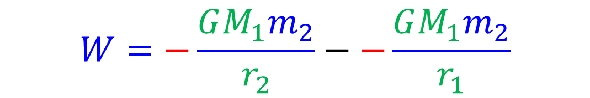


Work in a Non-Constant Gravitational Field
WORK is defined as the change in energy or the energy that is transferred to an object.
I’m not a big fan of work.
$$W=∆mgh$$
$$W=∆PE$$
$$W=PE_{2}−PE_{1}$$
$$W=−\frac{GM_{1}m_{2}}{r_{2}}−−\frac{GM_{1}m_{2}}{r_{1}}$$
PE 2 will reduce to zero at altitude
$$W=0+\frac{GM_{1}m_{2}}{r_{1}}$$

Slide 7
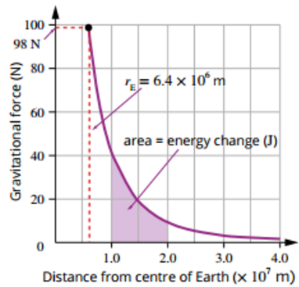

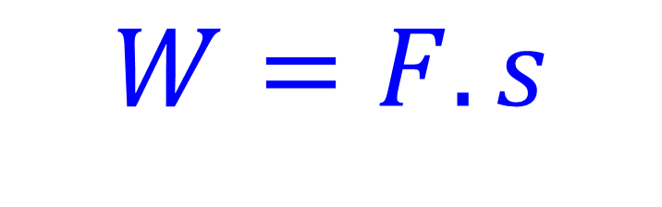
Work in a Non-Constant Gravitational Field
Gravitational force decreases with distance from the Earths centre as shown in the graph.
Work done can also be calculated by using this graph
$$W=F.s$$
Work done whilst moving between altitudes must therefore be equal to the change in area under the graph!

Slide 8





Escape Velocity
Escape velocity is the minimum velocity of an object required to overcome the gravitational pull of the planet that object is on to escape into space.
A larger planet has more mass and requires a much greater escape velocity than a smaller planet with less mass.
$$ME \left(on surface\right)=ME in space$$
$$KE+PE\left(Surface\right)= KE+ PE\left(Space\right)$$
$$v^{2}=\frac{2 GM_{1}}{r_{E}}$$
$$\frac{1}{2}m_{2}v^{2}+−\frac{GM_{1}m_{2}}{r_{E}}=0$$
$$v=\sqrt{\frac{2 GM_{1}}{r_{E}}}$$
$${{\frac{1}{2}m}_{2}v}^{2}=\frac{GM_{1}m_{2}}{r_{E}}$$

Slide 9

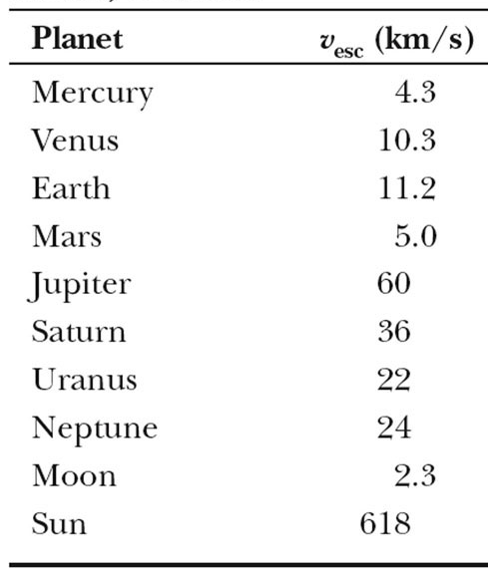
Typical Escape Velocities in our Solar System
My name is Groot!

